Slide 1
Personalizing Cardiovascular Simulations for Wearable Health Sensing
Tommy DeBenedetti, Parker Ruth

Slide 2
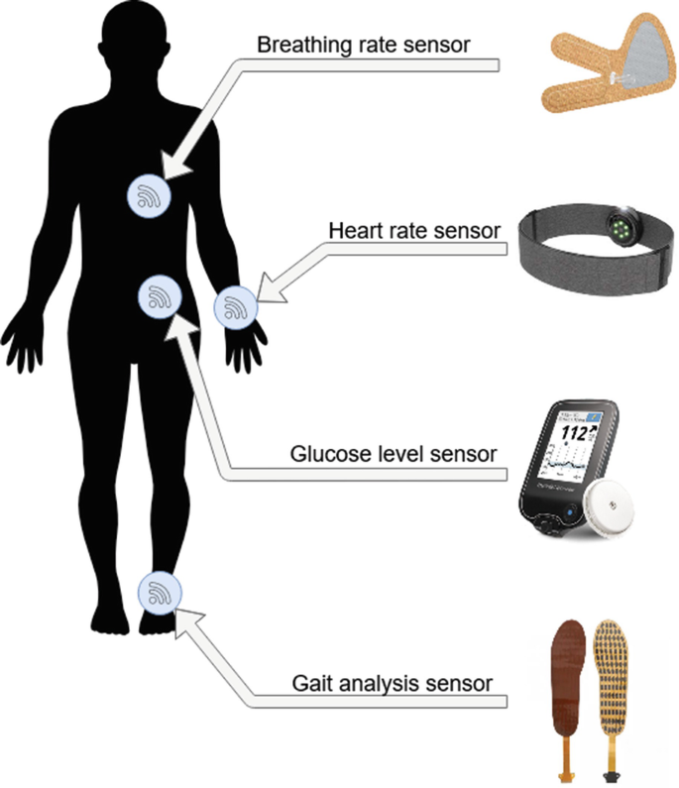
Wearable Technology Provides Crucial Health Data
Medeiros, A., Leme, L., Srivastava, G. (2022). An Introduction to Wearable Sensor Technology. In: Ghosh, U., Chakraborty, C., Garg, L., Srivastava, G. (eds) Intelligent Internet of Things for Healthcare and Industry. Internet of Things. Springer, Cham. https://doi.org/10.1007/978-3-030-81473-1_9
Notes:
As you guys know from our mid quarter update, parker has been working on wearable technology for cardiovascular health sensing, and i in particular have been working on ways to incorporate those devices and data in constructing cv simulaitons

Slide 3
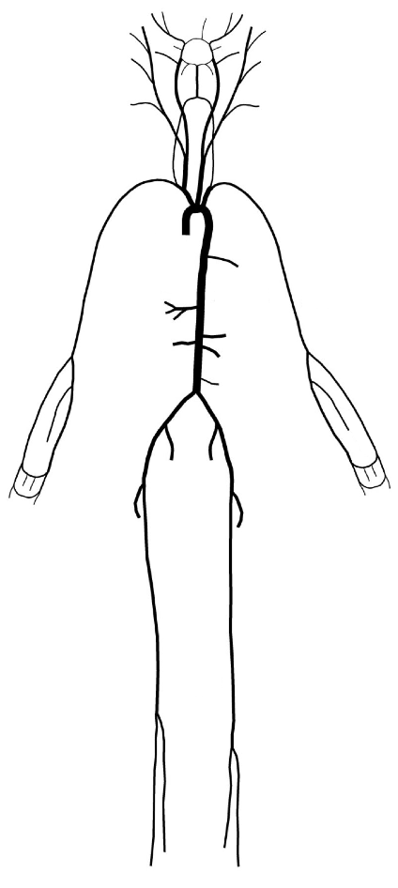
Proposing A Digital Twin Simulating the CV System
P. H. Charlton, et al., American Journal of Physiology-Heart and Circulatory Physiology, vol. 317, no. 5, pp. H1062–H1085, Nov. 2019, doi: 10.1152/ajpheart.00218.2019
Notes:
So the goal is a so-called digital twin — a computation model of a patient’s specific cardiovascular system. That we could investigate and manipulate temporally,

Slide 4
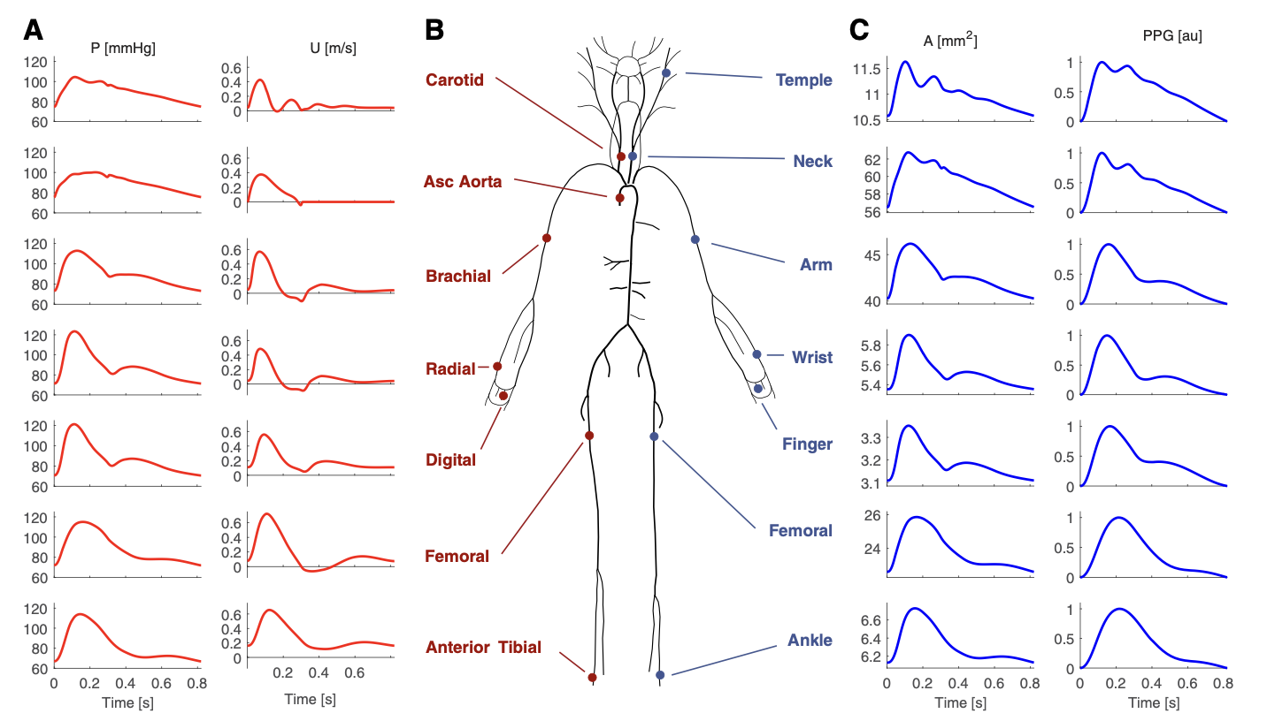
Proposing A Digital Twin Simulating the CV System
P. H. Charlton, et al., American Journal of Physiology-Heart and Circulatory Physiology, vol. 317, no. 5, pp. H1062–H1085, Nov. 2019, doi: 10.1152/ajpheart.00218.2019
Notes:
Provide some input to the system and see all of this

Slide 5
Outline
Designing model
Choosing dimensionality
Reducing model complexity
Fitting model to individuals

Slide 6
Outline
Designing model
Choosing dimensionality
Reducing model complexity
Fitting model to individuals

Slide 7
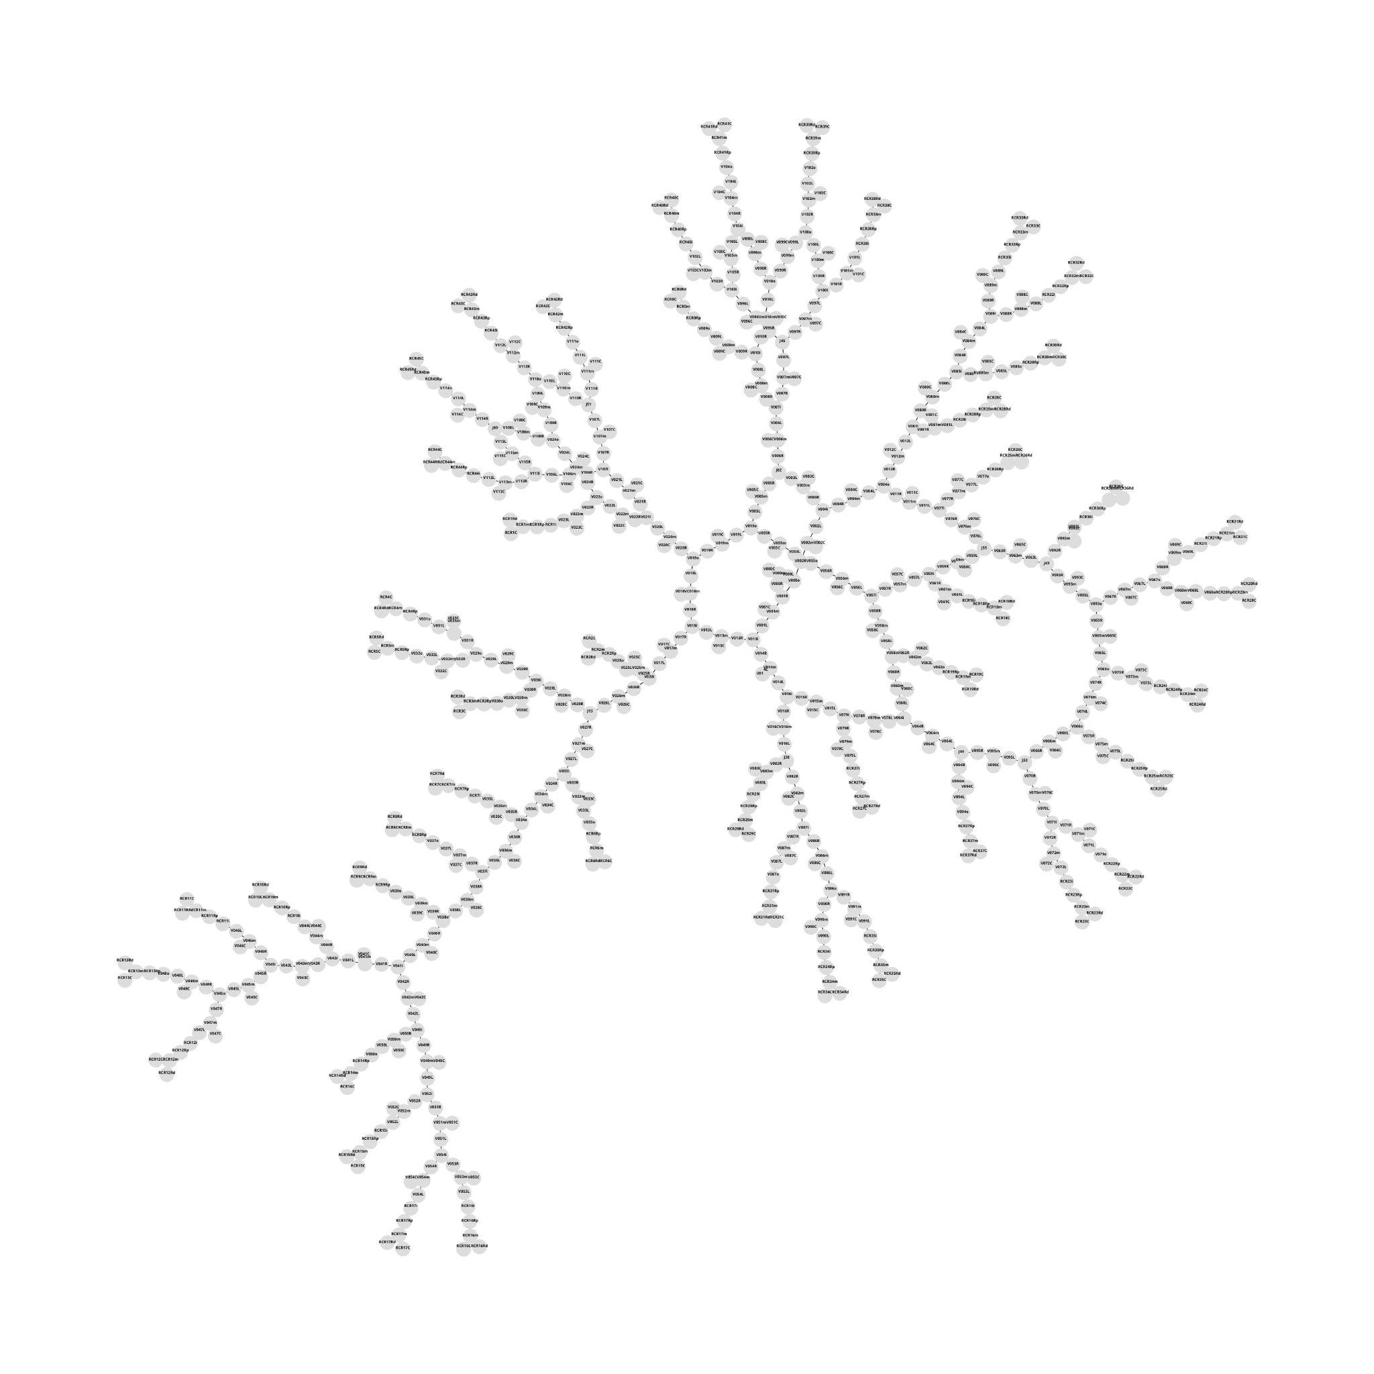
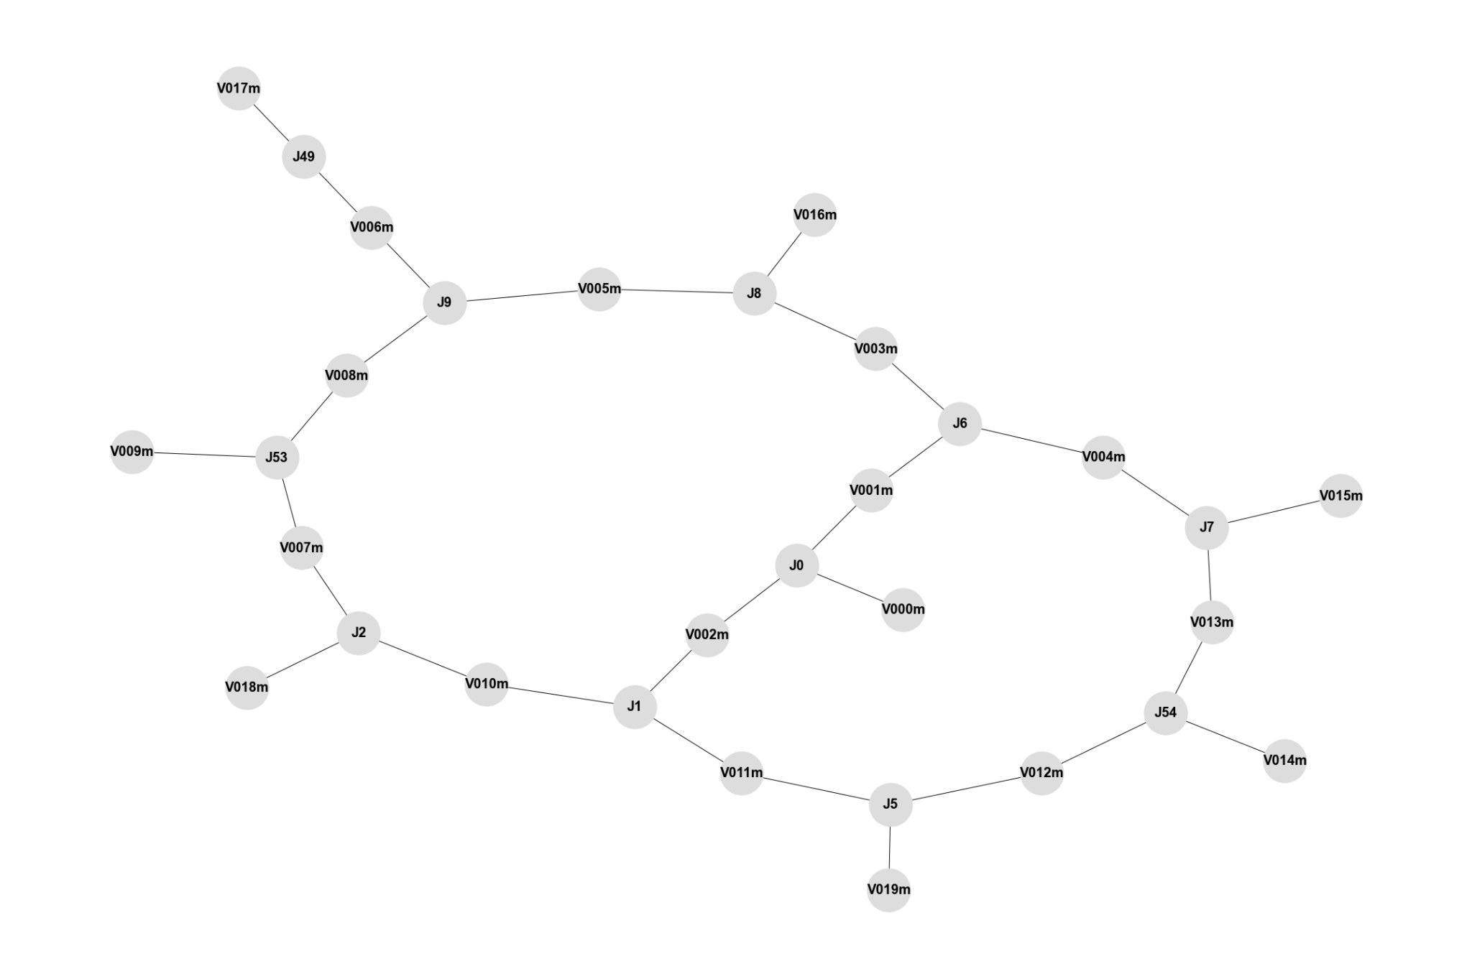
Reducing Model Complexity
116-vessel 1D
116-vessel 0D
???-vessel 0D
Notes:
How complex should this model be?
It should be able to capture sufficient complexity
But it should be feasibly simple for calibration
On the right we see what you can think of now as a loss function for our model across various model sizes
This may be sweet spot bc adding more blah blah blha
But what exactly the structure of this 20 vessel model should be, i took two approaches

Slide 8
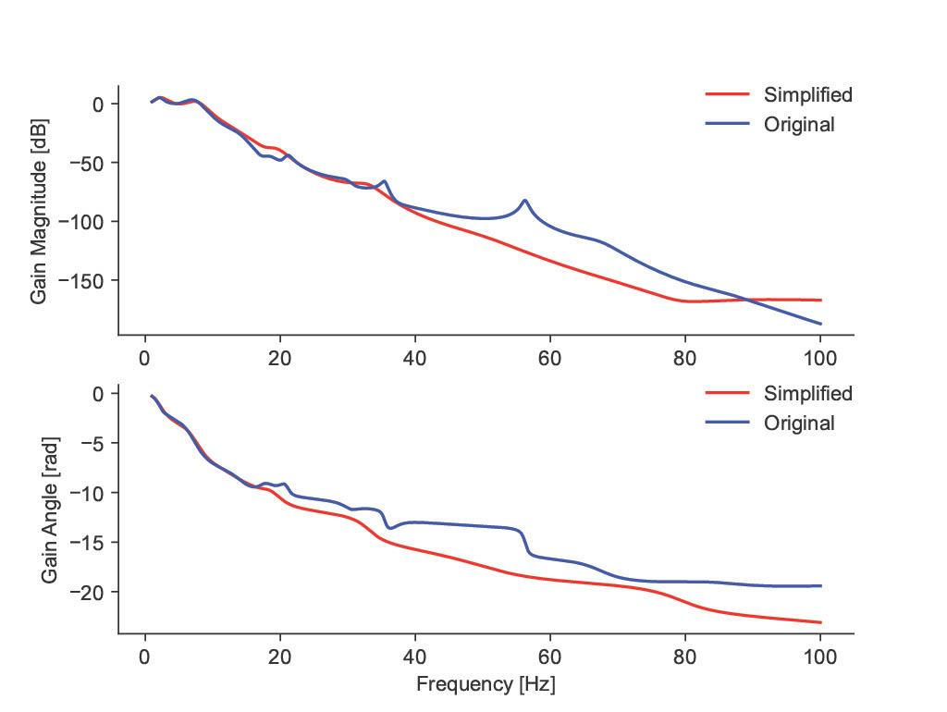
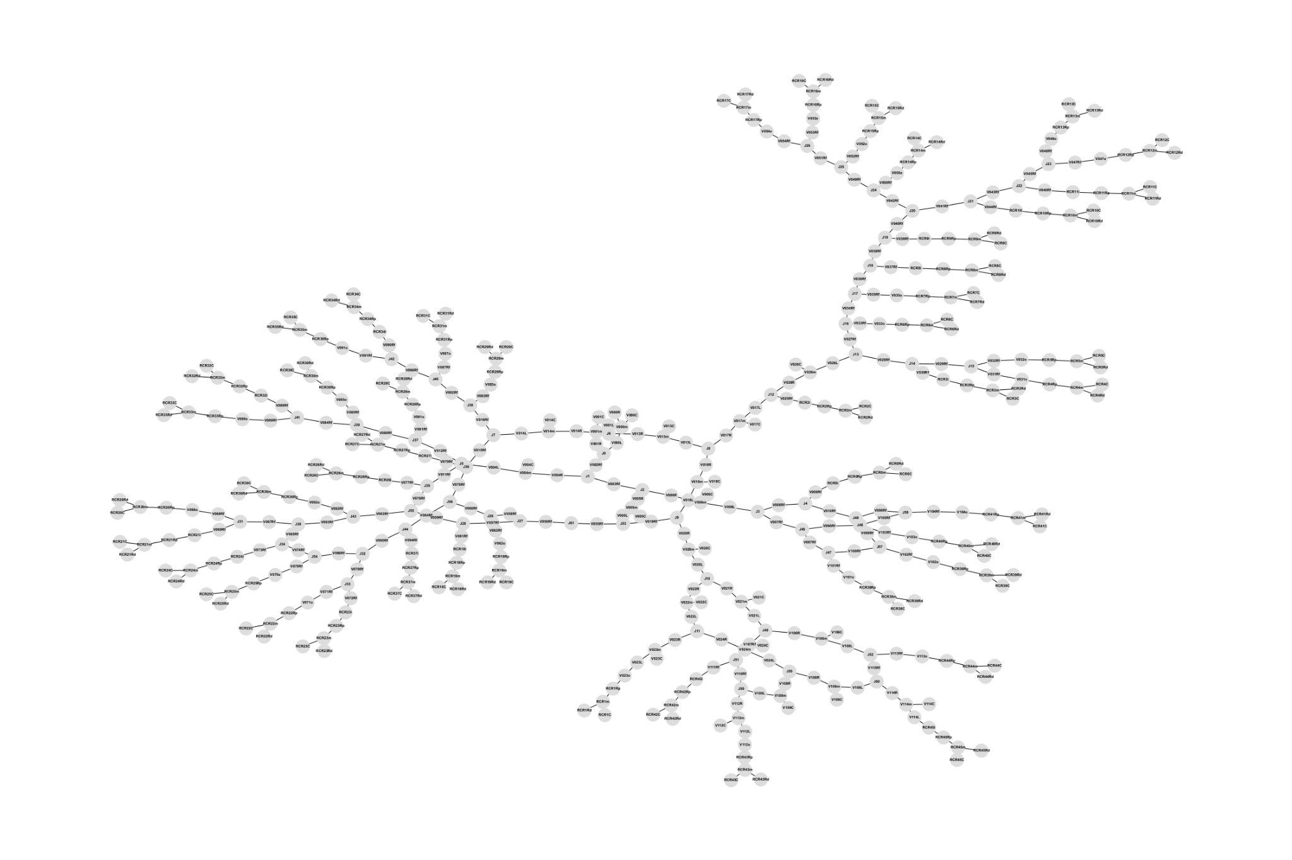
Top-Down Approach Sequentially Removes Vessels
Notes:
Mention that a subrange of this frequency range is important/most important for bp prediction, but at this pt in the project, we are just trying to theoretically perfectly represent the original circuit and so recreate its behavior over the whole freq range it operates over

Slide 9
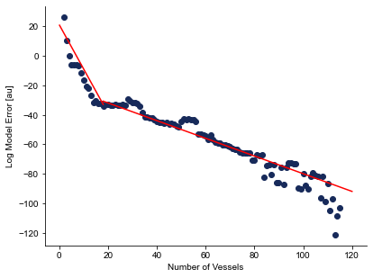
Finding Model Complexity “Sweet Spot”
More vessels → more detailed
Fewer vessels → simpler calibration
Notes:
How complex should this model be?
It should be able to capture sufficient complexity
But it should be feasibly simple for calibration
On the right we see what you can think of now as a loss function for our model across various model sizes
This may be sweet spot bc adding more blah blah blha
But what exactly the structure of this 20 vessel model should be, i took two approaches

Slide 10
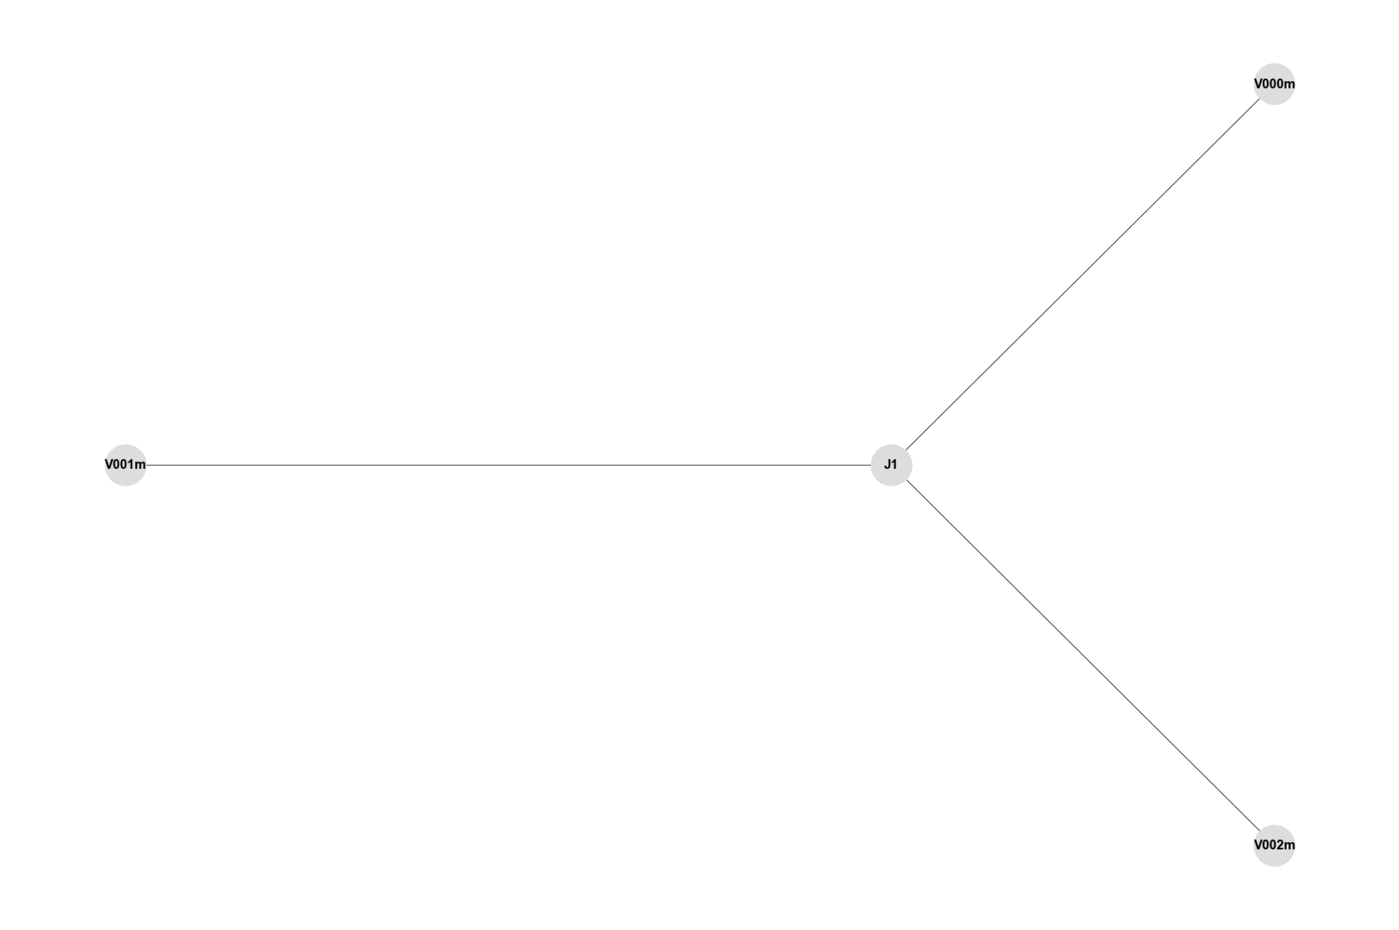
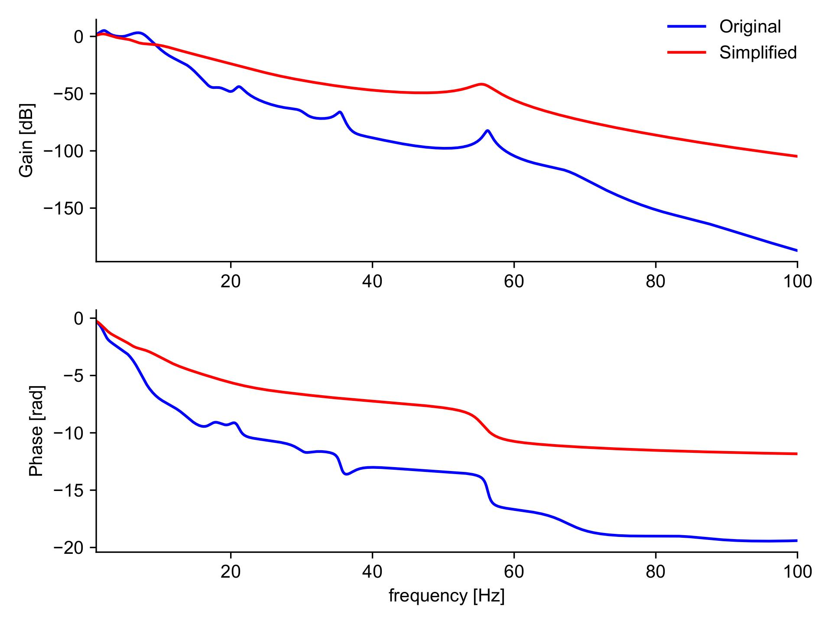
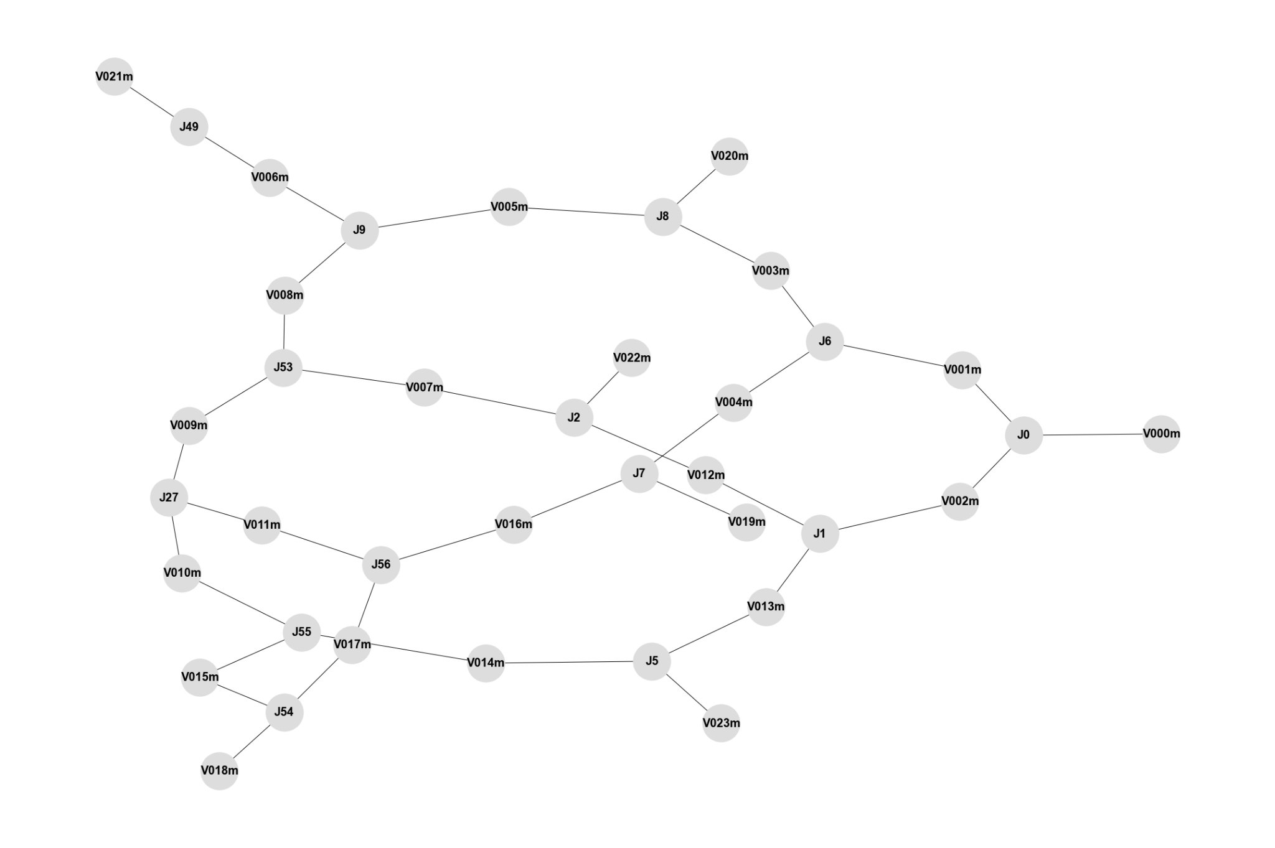
Bottom-Up Approach Designs Custom CV Models
Notes:
These were custom designed based on domain knowledge of the vasculature and what structures should be captured, did not perform as well

Slide 11
Outline
Designing model
Choosing dimensionality
Reducing model complexity
Fitting model to individuals

Slide 12
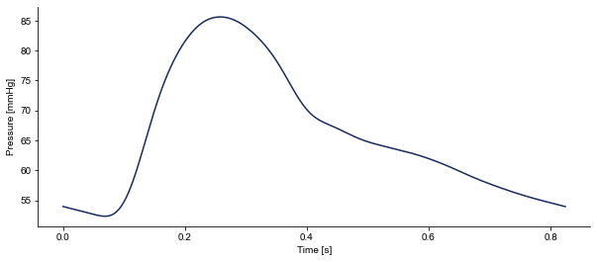
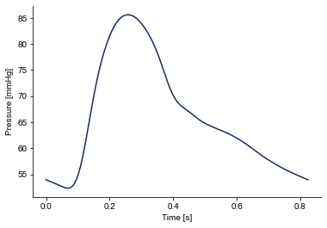
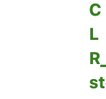
?

Slide 13
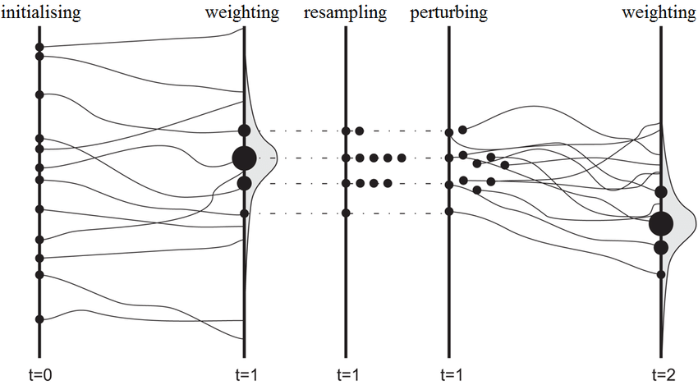
Sequential Monte Carlo: Leveraging Randomness to Search a Large Space
Montzka C, Pauwels VRN, Franssen H-JH, Han X, Vereecken H. Multivariate and Multiscale Data Assimilation in Terrestrial Systems: A Review. Sensors. 2012; 12(12):16291-16333. https://doi.org/10.3390/s121216291
Notes:
The algorithm i used here is sequential monte carlo
Uses iterative process of sampling and weighting based on the likelihood of a sampled parameter configuration to establish a distribution over possible parameter configurations

Slide 14
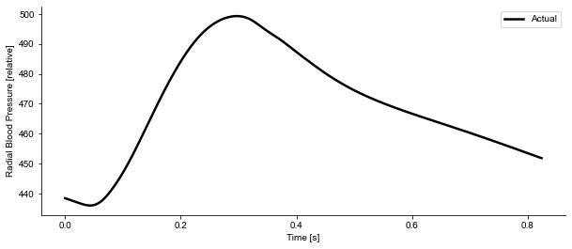
SMC Searches Parameter Configurations to Match A Radial Pulsewave

Slide 15
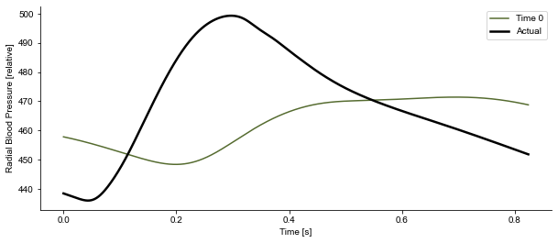
SMC Searches Parameter Configurations to Match A Radial Pulsewave

Slide 16
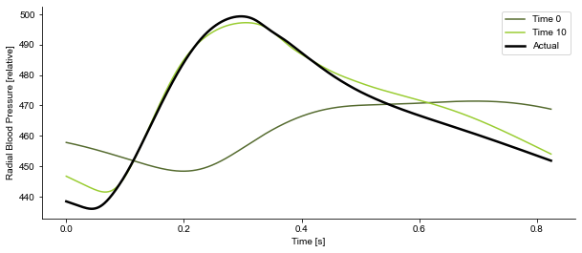
SMC Searches Parameter Configurations to Match A Radial Pulsewave

Slide 17
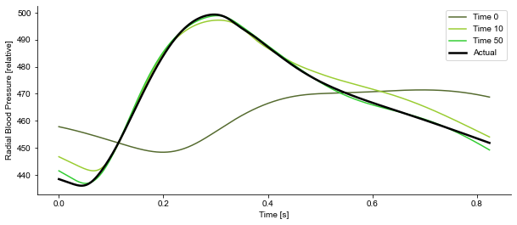
SMC Searches Parameter Configurations to Match A Radial Pulsewave

Slide 18
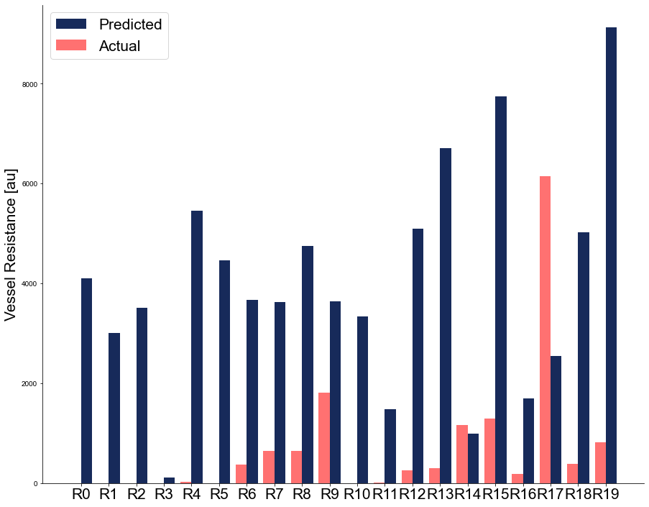
Multiple Parameter Configurations Produce The Same PW
Notes:
Possible next steps to resolve
Hyper parameter tuning on the model — number of particles, temperature of the perturbation
Or restrict the problem further — incorporating prior distribution over parameters or other data to calibrate to (like metrics at the radial artery other than pressure)
All things i would have liked to explore, but didn’t get around to this summer

Slide 19
Towards a Digital Twin Powered by Wearable Tech

